Slide 1


NORTHWIND WHOLESALE DISTRIBUTORS
DATA ANALYSIS
Collaborators
Zakria Saad
Pruthvish Kumar J
Tarik Suluc

Slide 2
AGENDA
Introduction
Data Description
Tools
Key insights
Conclusion

Slide 3
INTRODUCTION
Our objective was to study the data provided and examine the existence of any meaningful correlations between levels of sales, fiscal years, regions covered by employees, and shipping times to various locations.
20XX | 20XX | 20XX | 20XX

Slide 4
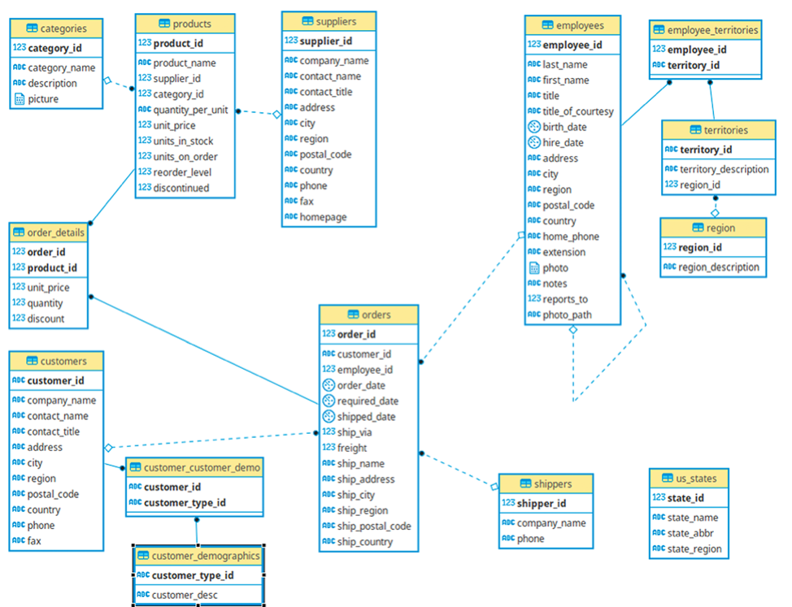
DATA
DESCRIPTION

Slide 5



TOOLS
DBeaver
SQL
Microsoft Excel

Slide 6
INSIGHTS
Impact of Employees on Sales
Sales (Yearly Sales/Top Selling Categories and Products)
Impact of Shipping Duration and Discounts

Slide 7

The Impact of the People
This portion of the presentation will explore the impact that people had on the sales of the company.

Slide 8
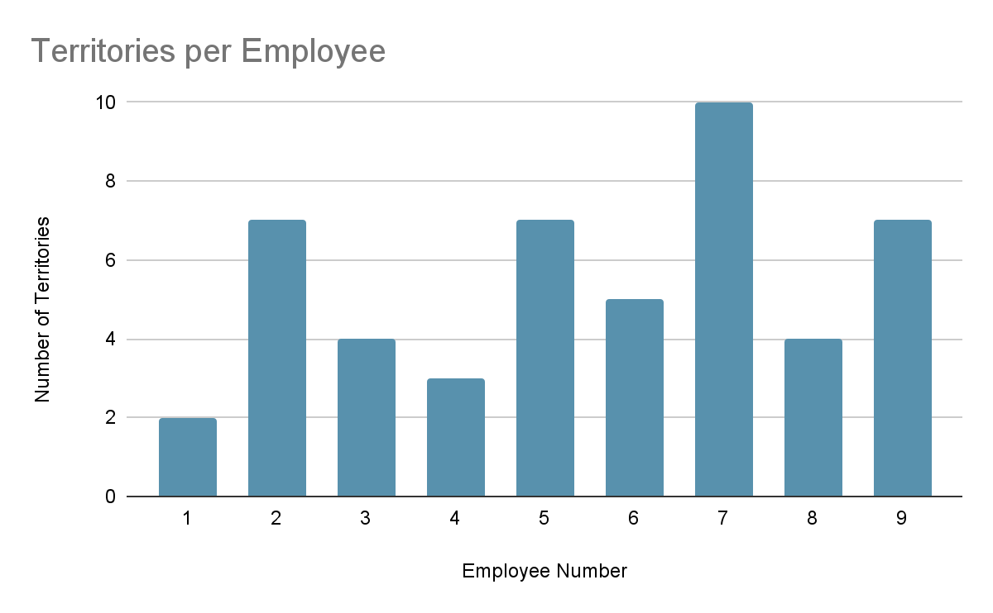
NUMBER OF TERRITORIES PER EMPLOYEE

Slide 9
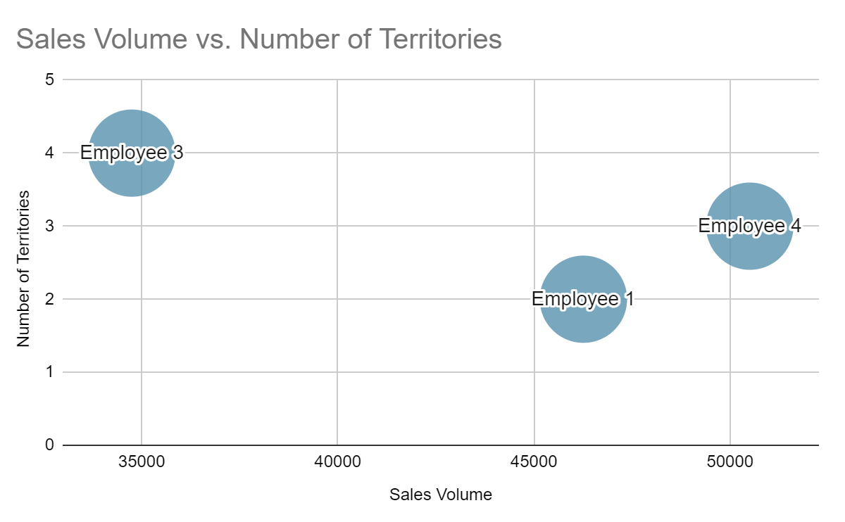
SALES VOLUME VS NUMBER OF TERRITORIES

Slide 10

Sales Insights
This portion of the presentation will explore the differing levels of sales across countries.

Slide 11
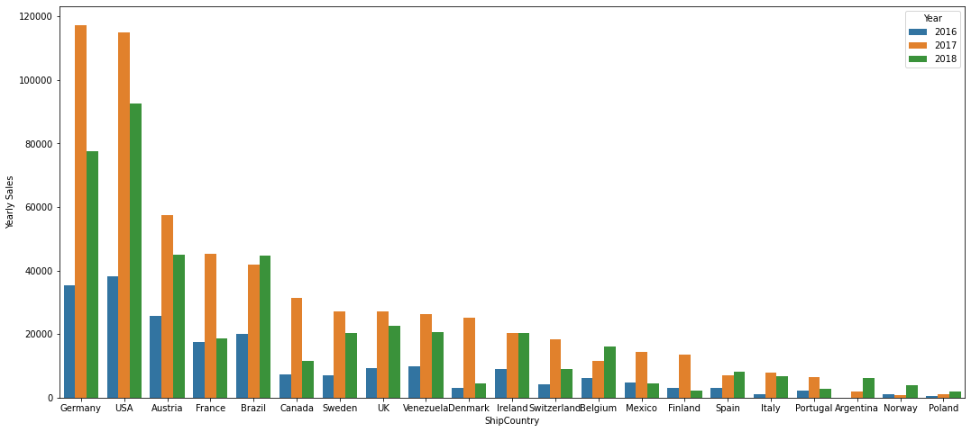
YEARLY SALES BY SHIPPING COUNTRIES

Slide 12
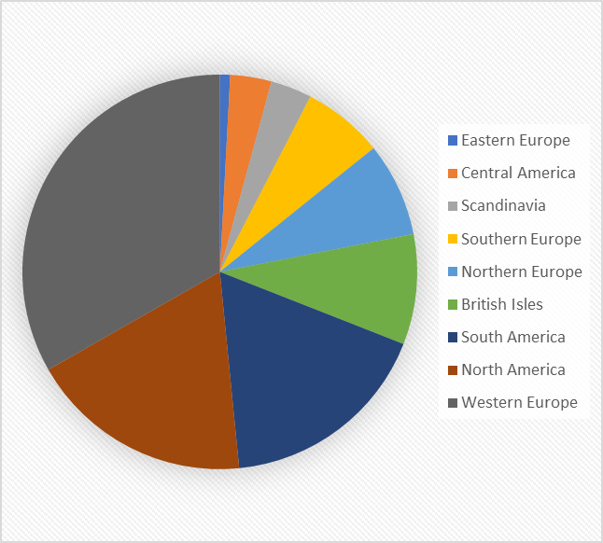
Order Amounts for Each Region
Regions​ | Order Amounts​
Eastern Europe​ | 7
Central America​ | 28
Scandinavia​ | 28
Southern Europe​ | 55
Northern Europe​ | 64
British Isles​ | 75
South America​ | 145
North America​ | 152
Western Europe​ | 276

Slide 13
Most Selling Category by Each Region
Regions​ | Most Selling Category
Eastern Europe​ | Beverages​
Central America​ | Beverages​
Scandinavia​ | Beverages​
Southern Europe​ | Confections​
Northern Europe​ | Beverages​
British Isles​ | Dairy Products​
South America​ | Beverages​
North America​ | Confections​
Western Europe​ | Beverages​
Using this data, we can prepare specialized ads for each region to increase the sales

Slide 14
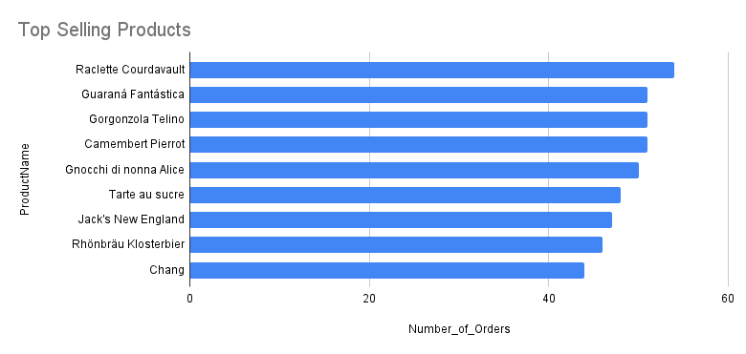
TOP PRODUCTS BY ORDERS

Slide 15
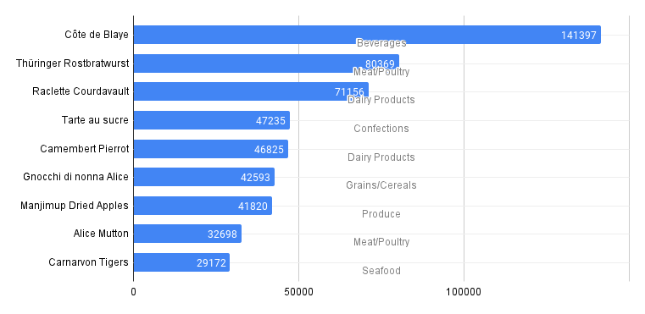
PRODUCTS BY SALES

Slide 16

The Impact of Shipping Times and Discounts
This portion of the presentation will explore the impact that different shipping times and discounts offered had on sales.

Slide 17
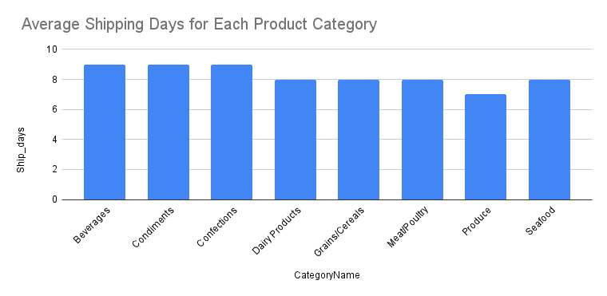
PRODUCT CATEGORIES W.R.T SHIPPING TIME

Slide 18
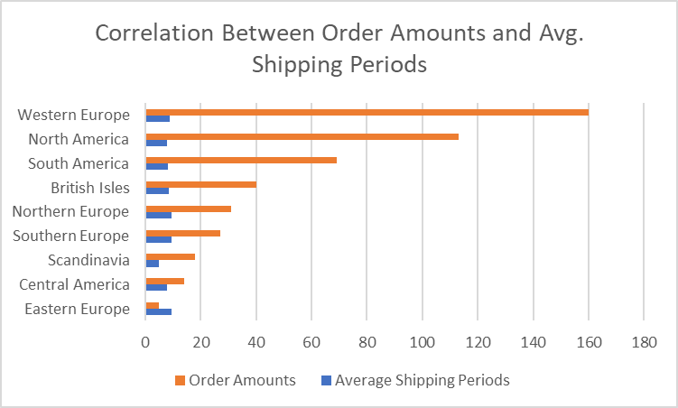
AVERAGE SHIPPING TIME AND TOTAL SALES

Slide 19
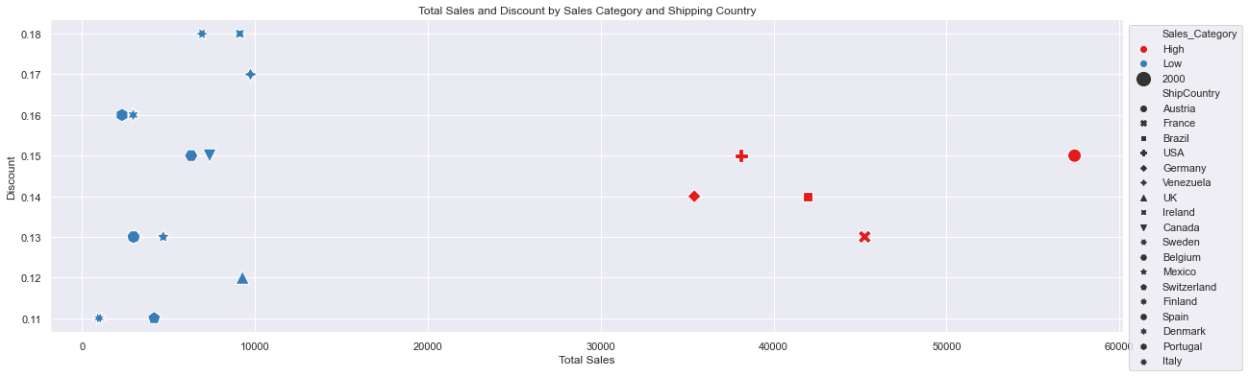
THE EFFECT OF DISCOUNTS ON SALES
Notes:
The 2 pricing categories we are examining in the query is the Low sales region and the High sales region
The low sales region are:
Mexico
Finland
Spain
Italy
Portugal
Argentina
Norway
Finland
The High sales region are:
USA
Germany
Austria
Brazil
At the first glance you will notice there is positive relationship between discounts and sales in the high sales region as an increase in discount lead to and increase in sales and as discount rate falls it also reduces the sales in the low sales region, there was a slight dip in discount rate in Austria and that affected the volume of sales.

Slide 20
CONCLUSION
Northwind has seen an increase in sales from 2016 to 2018.
The distribution of territories amongst employees is inefficient.
Beverages are the highest-selling items in most regions.
The highest number of orders are from Western Europe.
Overall Discount is having no impact on sales.
Shipping time has no impact on sales.

Slide 21
THANK YOU

